Slide 1
Presentation
Presenter’s Name: Aryan Vashistha
Mentor: Arun Adoni

Slide 2
Automation in Spotfire
Automation of File Handling in Spotfire (Using Iron-Python)
Generating Report of Current file in ppt format (Using Python , Iron-Python)

Slide 3
1) Automation of File Handling in Spotfire (Using Iron-Python)

Slide 4
1) Automate the file handling/loading in Spotfire
Iron-Python is a Script used in Spotfire to interact with the interface of the software
The objective of the project is to automate the process of file upload on Spotfire.
Files are dumped from the tester in a folder and we manually upload the latest file and refresh the Spotfire.
Automating the manual process to get the latest file from the folder and uploading the data in Spotfire using Iron-Python
If the latest file is in 2 parts (Header and Data ) ,It converts the file automatically into a single file and uploads the combined file in Spotfire

Slide 5
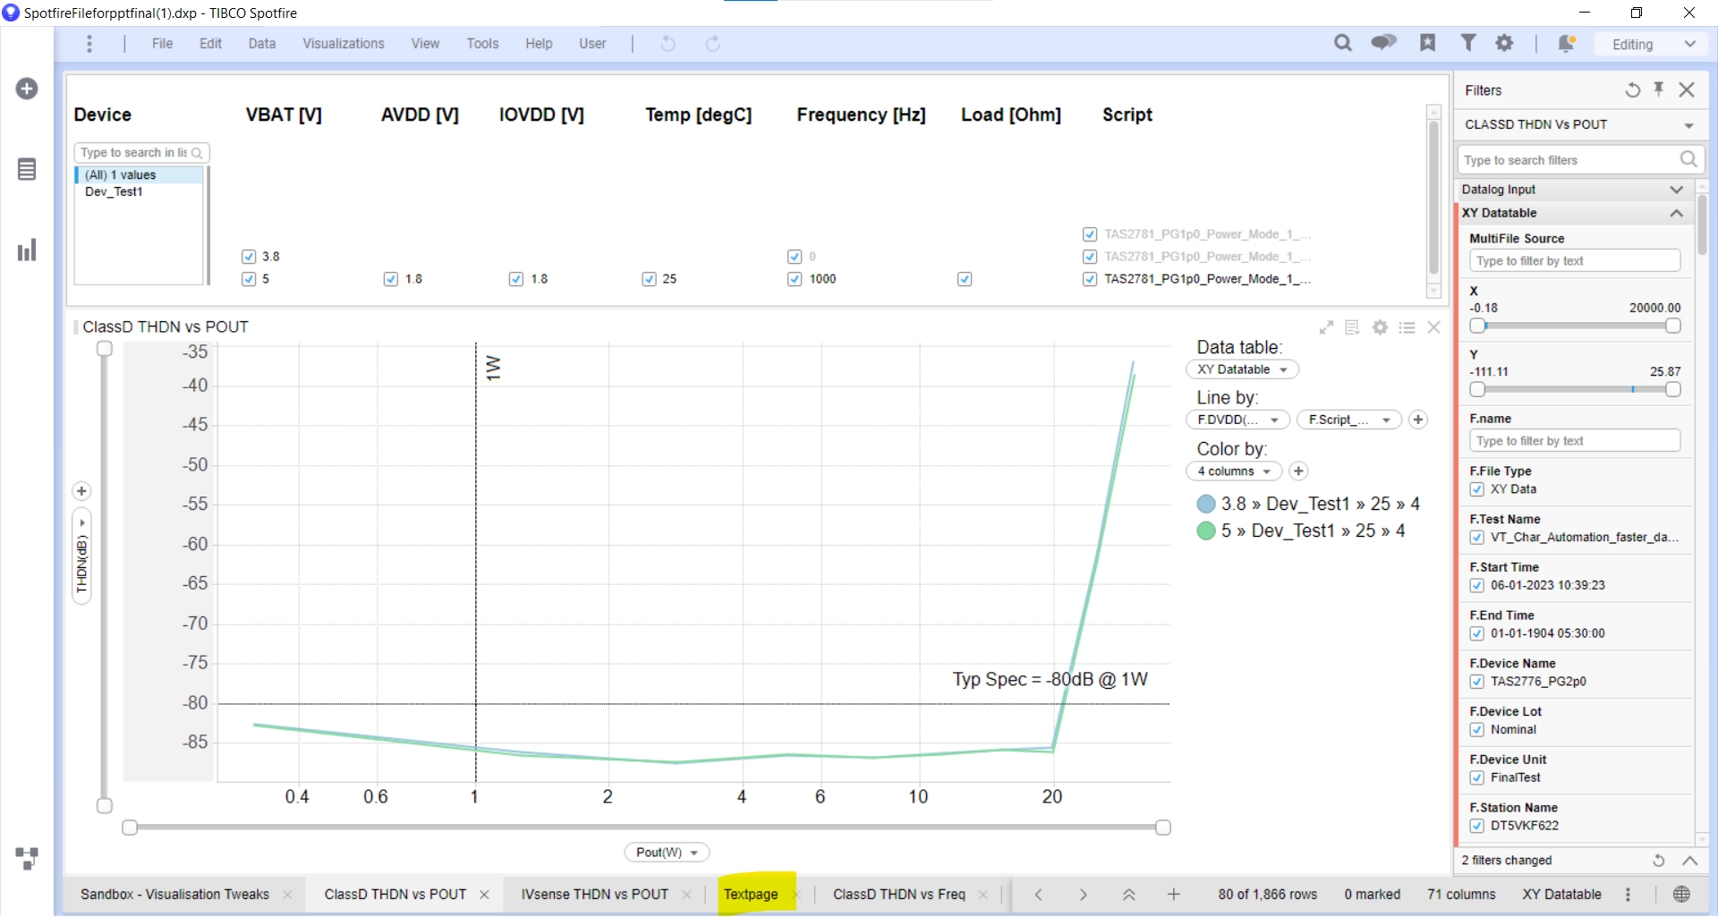
Interface of Spotfire :

Slide 6
1) Automate the file handling/loading in Spotfire
Multiple files are dumped into a folder location and we have to Upload and Reload the required file in the Spotfire
The script will take the address of the folder in the text area and on pressing Go button it will updated the Spotfire with the latest created file.If the latest file is present into two parts as Header file and Data file then this code will merge two files into a single file as combined file and upload this file in the Spotfire
Iron python Script: We will ask user to give the location of the folder in which our files will be stored .We will iterate through each file to check for the latest and second latest file by iterating through the files . If the latest file is in correct format then it will directly update the spotfire with this file.
If the latest file is Header or Data file then it will merge it with the second latest file accordingly taking into consideration all cases and upload the merged file in the spotfire displaying a message that the file has been uploaded with its address.

Slide 7
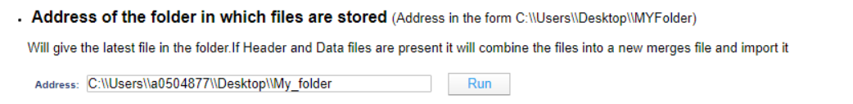


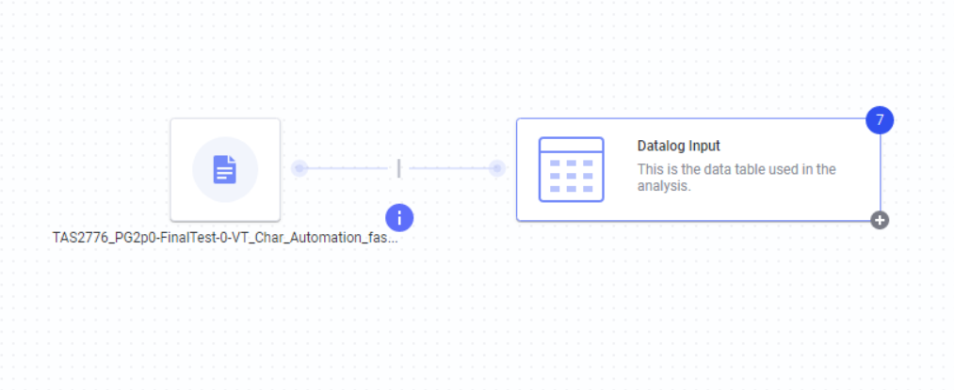
Working of the Script
Text Area in Spotfire :
CASE 1 : If the latest File is Complete File
The latest file(TAS277_Pg…) is updated on Spotfire and all the visuals can be seen for that file in different pages
ON PRESSING RUN
(Will take the
Latest file from the folder and load that file on Spotfire and plot corresponding visuals)
Folder in which Files are Dumped by the tester
Latest File Uploaded in Spotfire

Slide 8

CASE 2: If the Latest File is broken into Header and Data File
File1 (Header)
ON PRESSING RUN
For the latest file it will
Will merge the Header and Data file into a combined file
File1 (DATA)
Folder in which multiple Files are dumped by the tester
File2
Combined File
Uploads the Data in Spotfire
File3

Slide 9
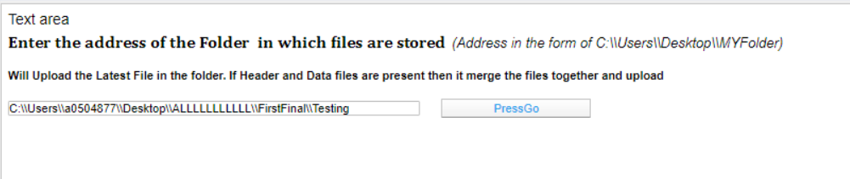
Input in Text Page
Button for Script

Slide 10
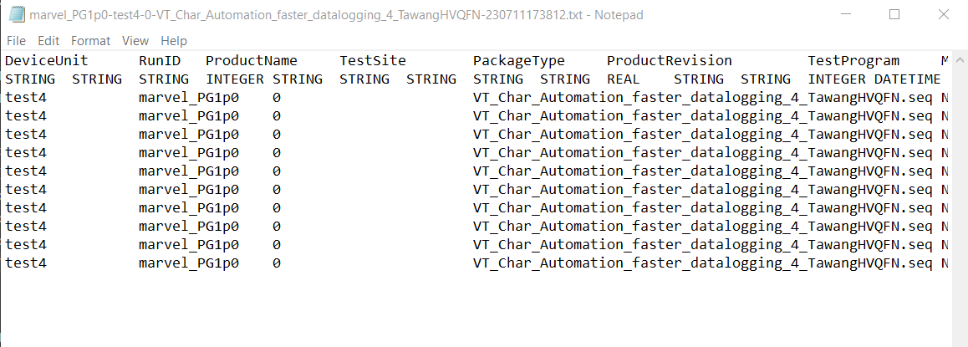
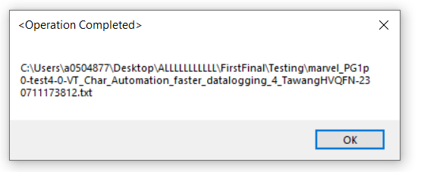
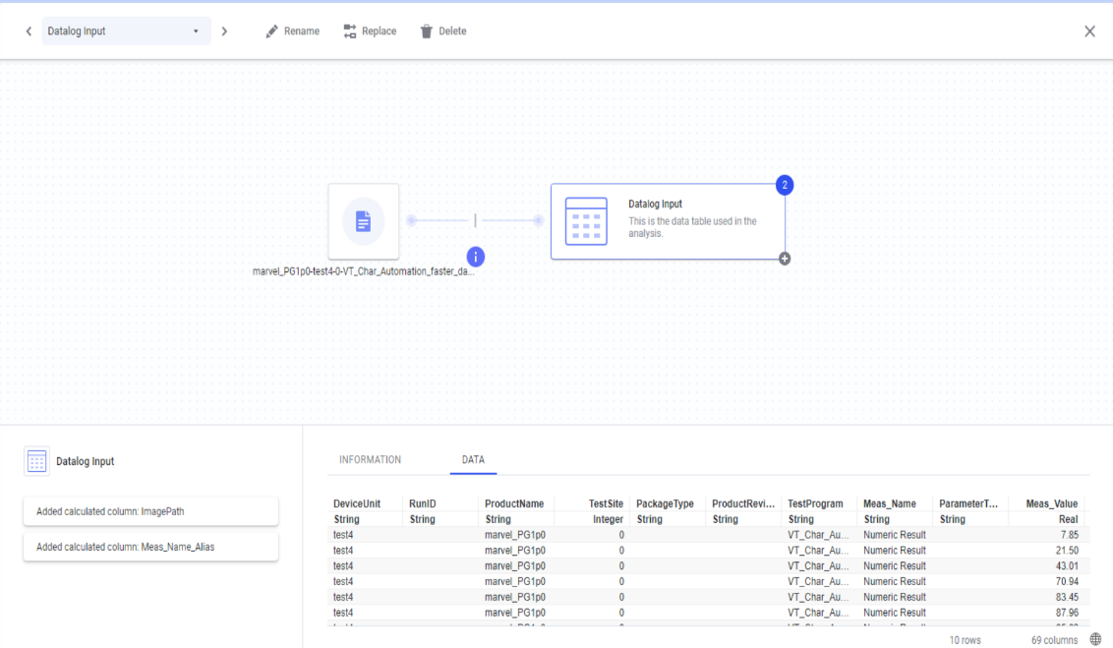
File

Slide 11
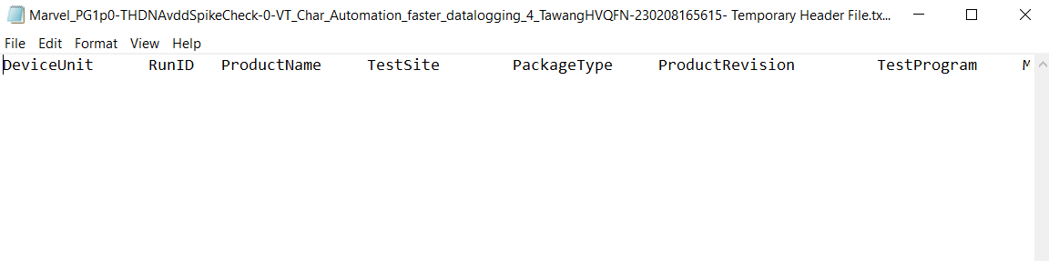
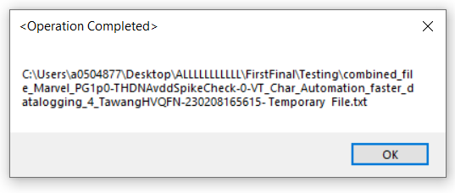
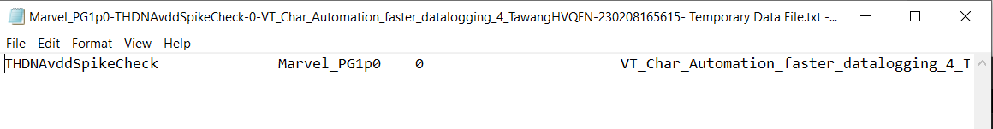
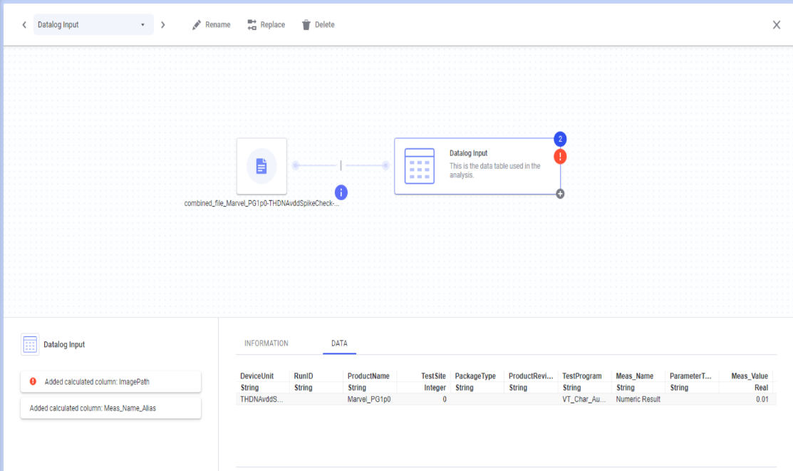
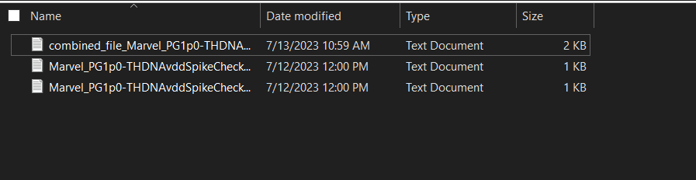
Header
Data

Slide 12
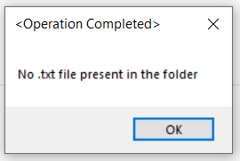
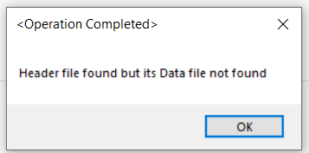
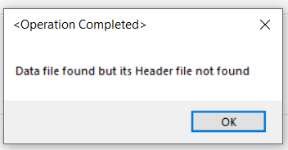
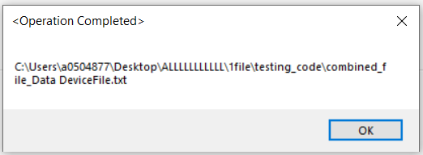
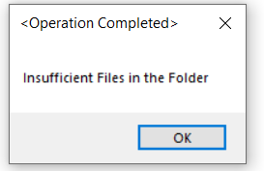
Error Handling

Slide 13
2) Generating a report of the Current file in ppt format using (Iron-Python and Python Script)

Slide 14
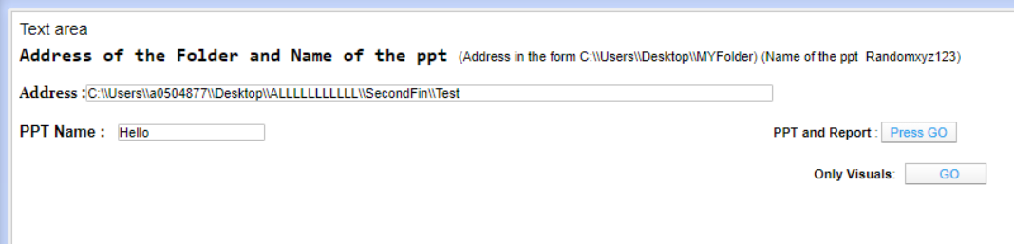
Input in Text Page in Spotfire
Pressing this button to Export Visuals along with Analysis
Faster:To export only the
Visuals of the file
User gives the the Address of the folder to store the report in ppt format, and give a name of the output ppt

Slide 15
For the active File in the Spotfire If we press the Press Go button then we get the ppt in the desired location with the Visuals and Analysis
Spotfire has different pages and every page has different visuals
Different Visuals are formed by different files (Data log Input or XY Data log)
Every visual is formed based on the filtering conditions applied on the particular file
Every visual is grouped by using particular columns and Graphs are plotted
The Y expression of the can be any mathematical expression as the function of the column
Final code works on Iron-Python Script and Python Script and should be able to do overcome all the problems

Slide 16
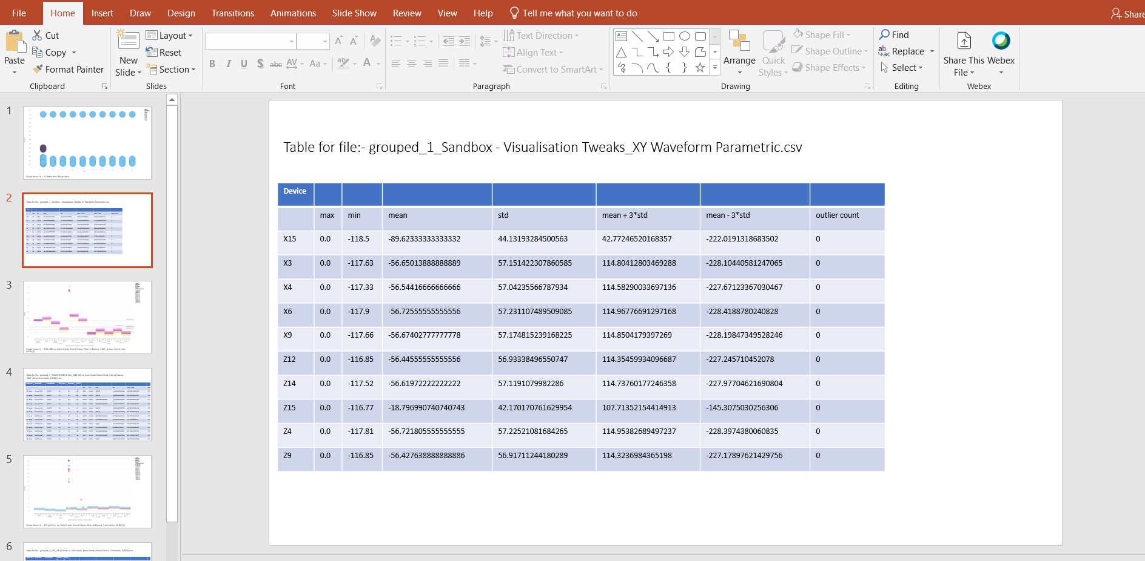
Output PPT formed by pressing PressGo
Grouped by the x axis expressions

Slide 17
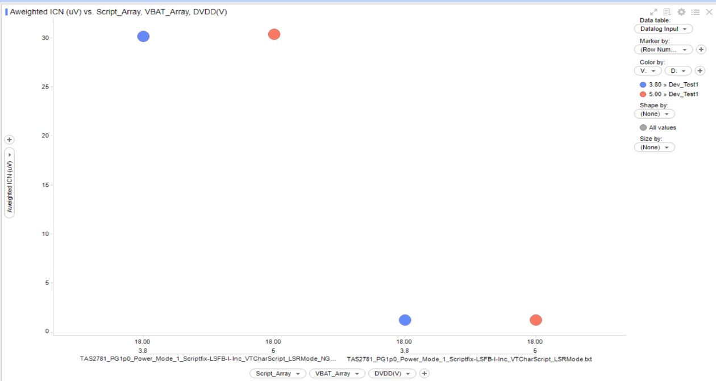
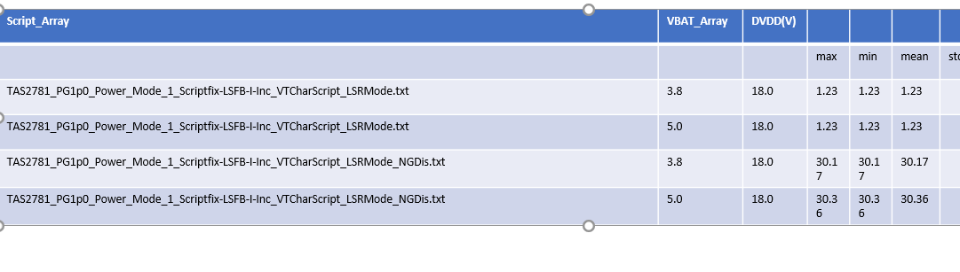

Slide 18
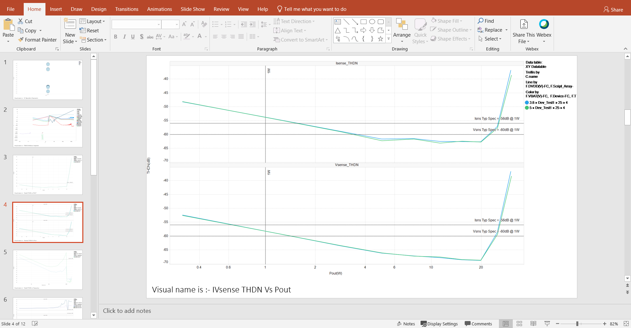
Output PPT formed by pressing “Go”

Slide 19
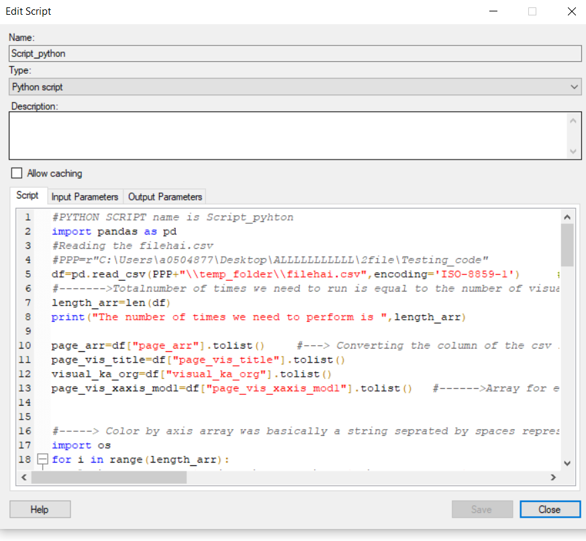
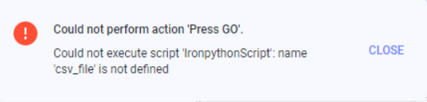
Error Handling
If this error is encountered then uncheck Allow Caching

Slide 20
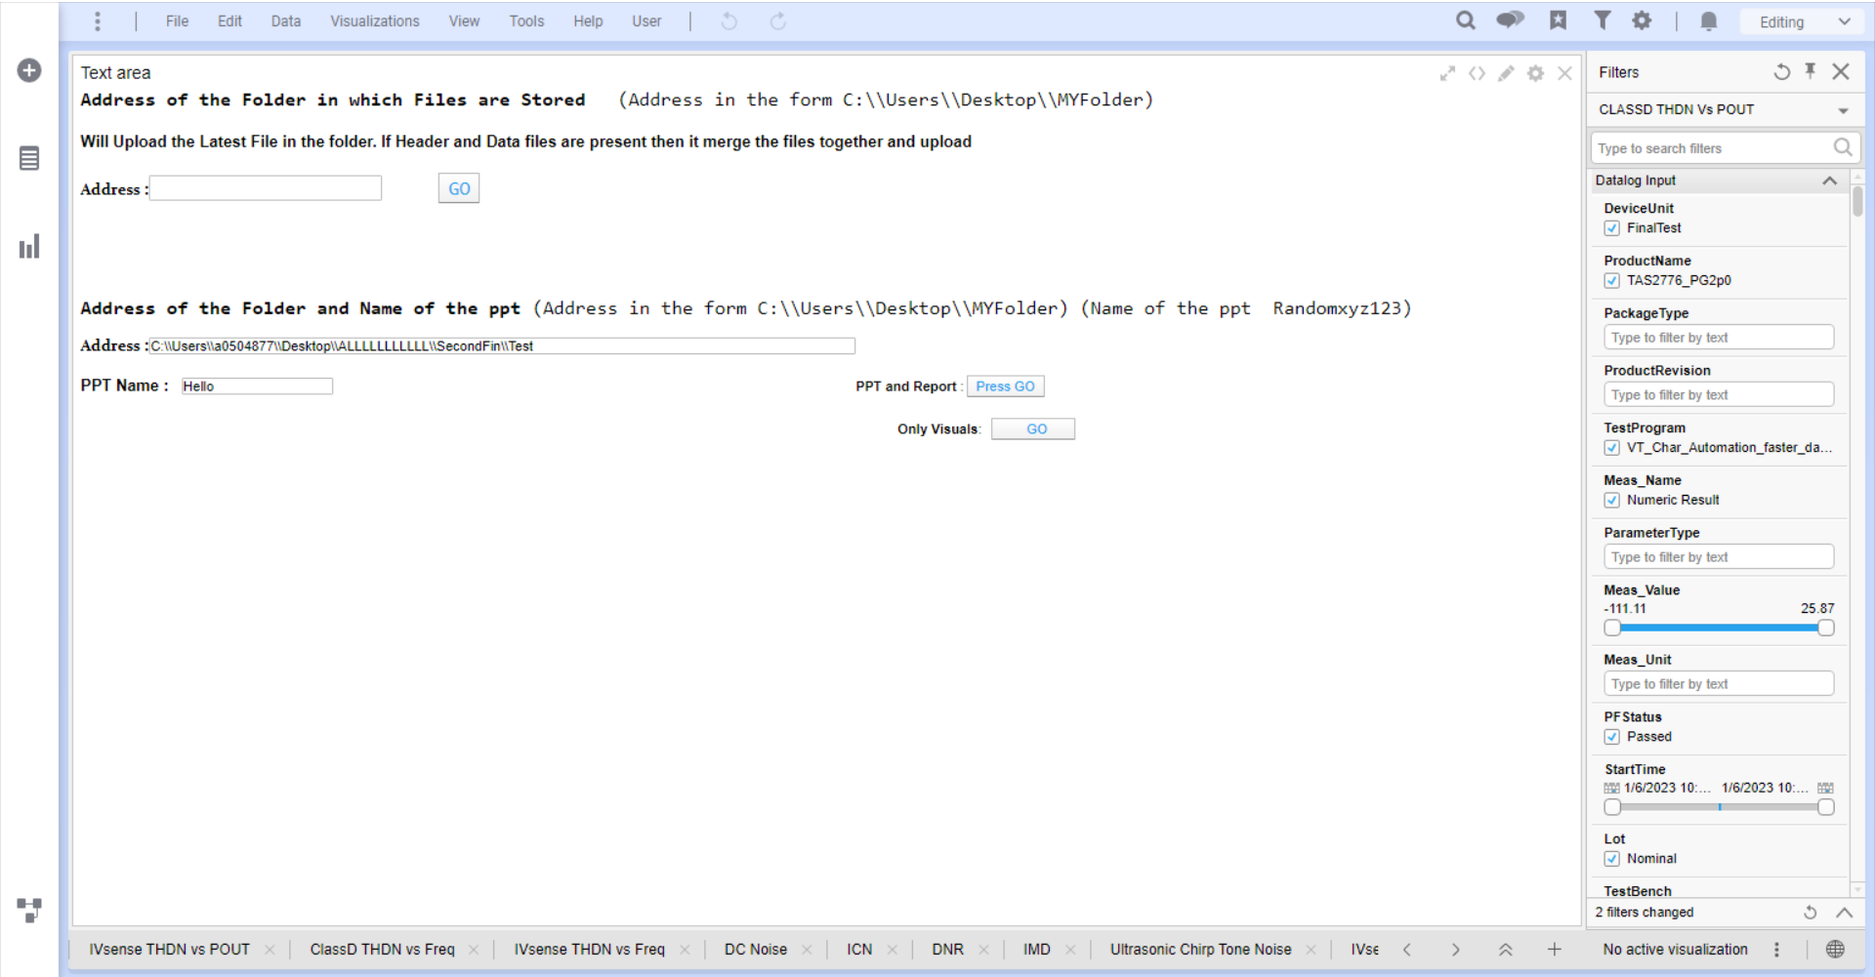
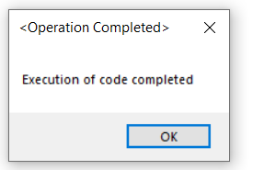
Combining Both into a single Text Page

Slide 24
Problem statement 2: Creating a GUI Based Analysis tool for ATE Data logfiles

Slide 26
Outline
Aim – To Automate the generation of various Data analysis reports/summary needed for ATE
In engineering development, this tool can be continuously fed log files as and when any data is collected and continue to have an idea of marginalities or instabilities or data distributions during development.
In production data analysis, the tool can be used specifically to understand the yield losses, site – site skews or lot –lot skews seen, understand the data distributions for high volumes, Cpks.
The tool gives a summary on the
type of distribution/skews
Generates the histogram plots for visual analysis
Data statistics / Cpk
Site wise Mean / Sigma drifts
Site wise distributions & statistics
Lot wise Mean / Sigma drifts
Notes:
Talking about the Engineering File and The production File

Slide 27
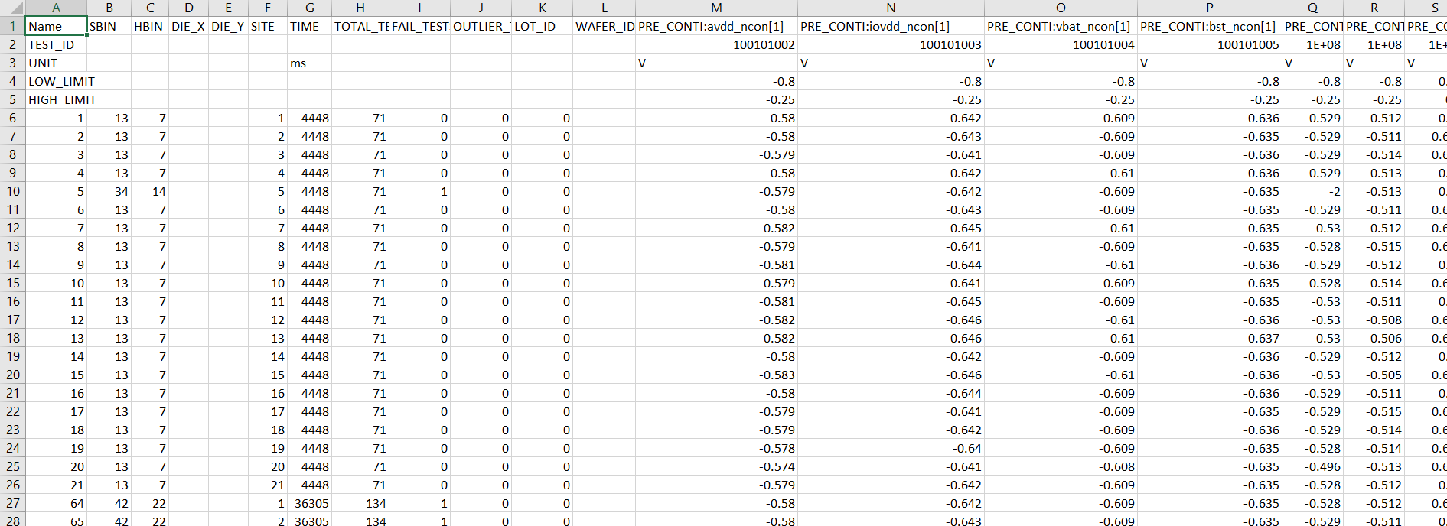
Input File: Engineering File
Parameters
File has information related to Parameters which are tested for the device along with its specified Low_Limit and High_Limit values ,Site in which the device was tested etc
Notes:
Engineering File

Slide 28
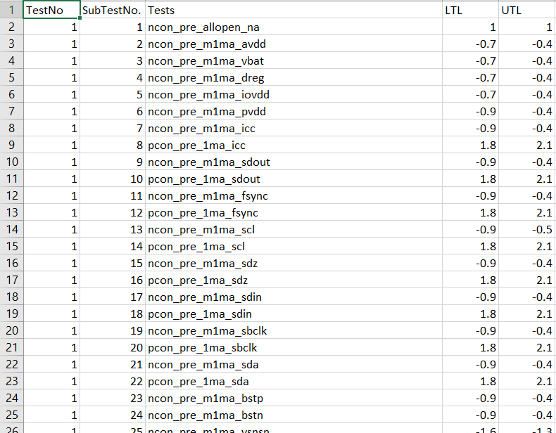
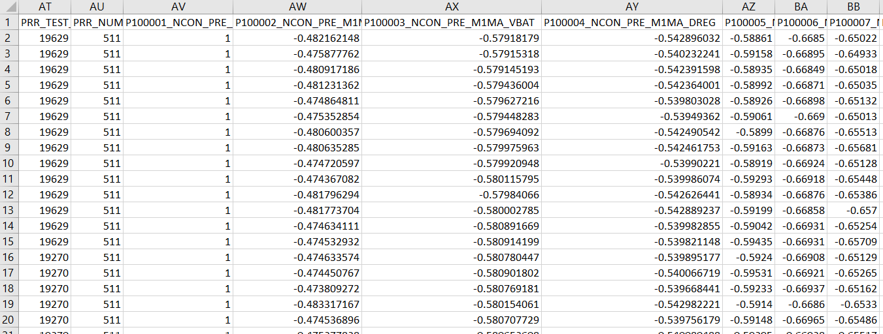
Input Files:Production
Parameters
(Testing File) (Limit File)
For the Production File Analysis we give two Input files .The Limits are mapped automatically to the parameter with the help of code
Notes:
Production File and the code how it works

Slide 29

Creation of the .exe file
Exe file is created that can be easily shared and will work on every system even if Python and the necessary libraries are not installed
The GUI can work for Data log Files from the tester which includes Engineering File and Production File
Standalone exe file

Slide 30
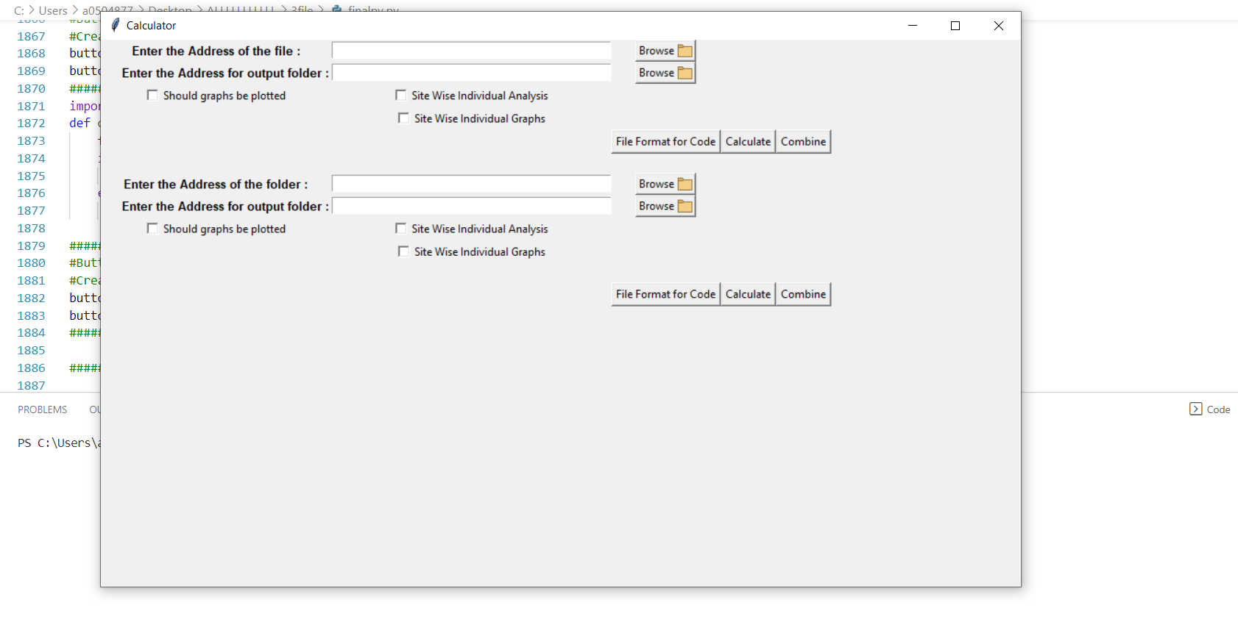
GUI For Engineering File
Input file address
Output Folder address
Checkmarks
Frequency response of AUX-0025 filter
Format for input file
For Multiple File
.Flat Band till 20kHz

Slide 31
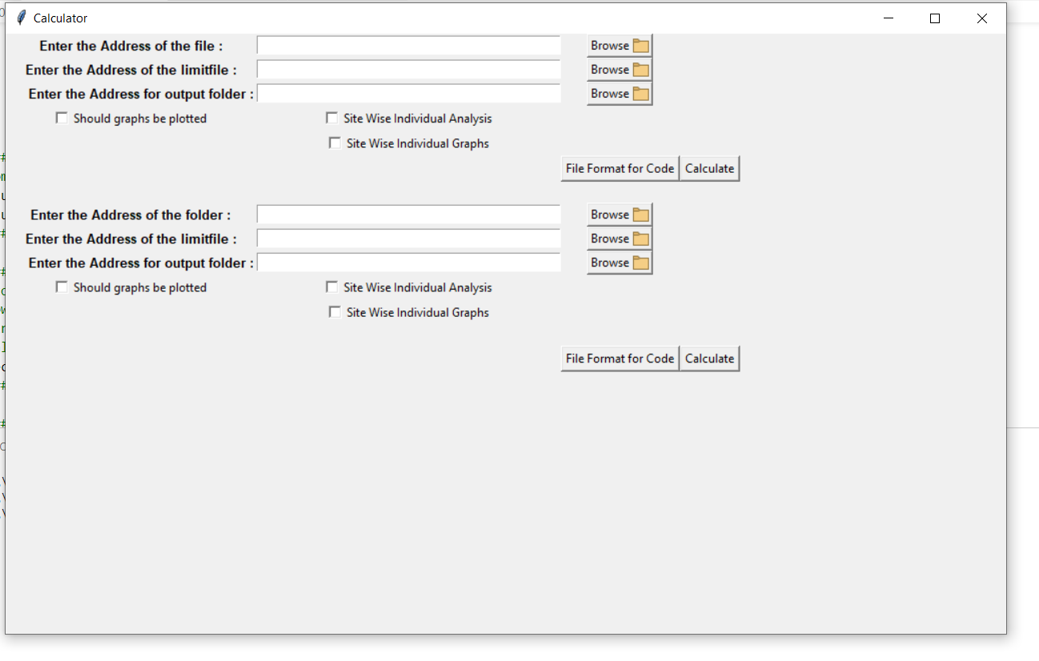
GUI For Production File
Testing File
Limit File
Checkmarks
Frequency response of AUX-0025 filter
For Multiple File
.Flat Band till 20kHz

Slide 32
Proposed solution :Engineering File temp
Overall File analysis
Number of outliers
Overall File analysis without outlier
CPL ,CPU and CPK
Created a GUI based tool that can perform
Graphs for all the parameters
Site wise Analysis
Intermediate Files
Graphs for all the Individual Site parameter
Site wise Distribution
Multiple File Analysis Feature

Slide 33
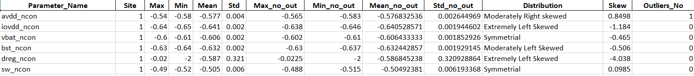
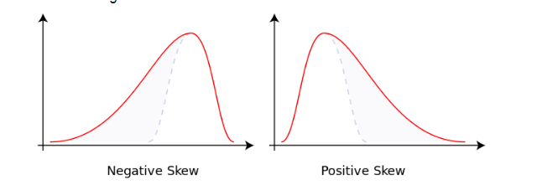
Proposed solution :Engineering File
Created a GUI based tool that can perform following operations:
Overall File analysis :Finds Max,Min,Mean,Std for all the parameters.
For every parameter we can get these values which gives us understanding about the overall value of a particular parameter and how much deviation is there
Skewness is measured with the help of skew(df[col]) which returns a numerical value based the spread of the data with respect to the mean of the data. High value of Skew means data is either left skewed or right skewed

Slide 34
Proposed solution :Engineering File
Skewness is measured with the help of skew(df[col]) which returns a numerical value based the spread of the data with respect to the mean of the data. High value of Skew means data is either left skewed or right skewed
By default skew() function is a biased estimator which means it assumes the dataset is a sample from a large dataset
Skewness is calculated by (1/n)* sigma (Xi-X)^3/(std)^3.Where Xi is the every data point and X is the Mean,Std is the standard deviation and n is the total number of data points
Number of outliers: Number of outliers and Max,Min,Mean,Std values for all the parameters after removing the outliers. Also includes Mean+6 *Std and Mean-6*std before and after removing the outliers for every parameter.
Since outliers can affect the values of the parameters. .All the outliers are removed within the range and corresponding values of Max,Min,Mean etc are calculated

Slide 35
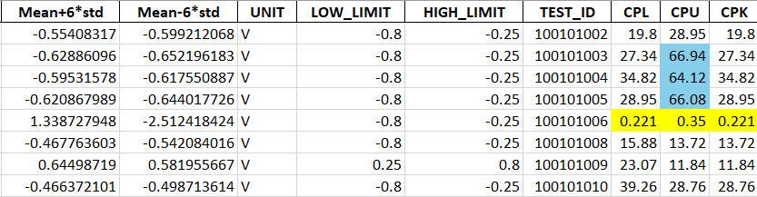
CPL ,CPU and CPK : Finds the CPK,CPU and CPK values for all the parameters before and after removing the outliers
Marks the bad CPL ,CPU ,CPK values in the output for the user
Threshold of the value is 1.8 to 30

Slide 36
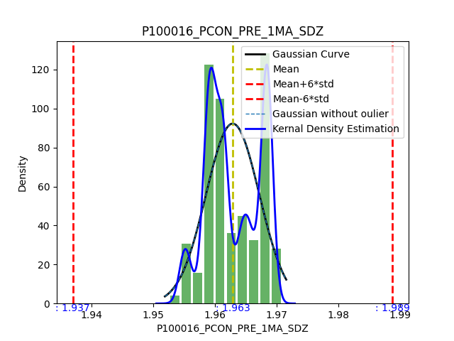
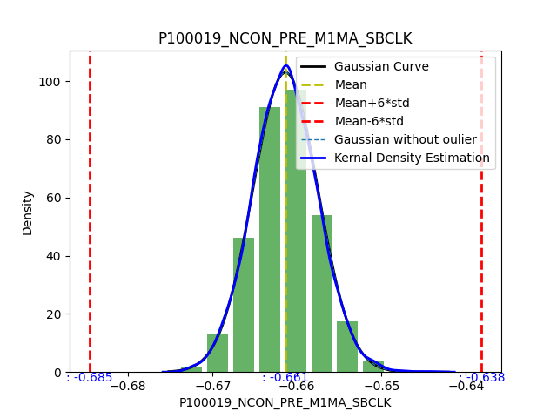
Graphs for all the parameters: Adding a checkmark in GUI that will save the distribution for every
parameter in given Folder Location to check how a parameter is performing overall on all the sites which includes Histogram ,Gaussian Curve without outliers, Gaussian Curve with outliers ,Kernel Density plot , vertical lines specifying mean , std

Slide 37
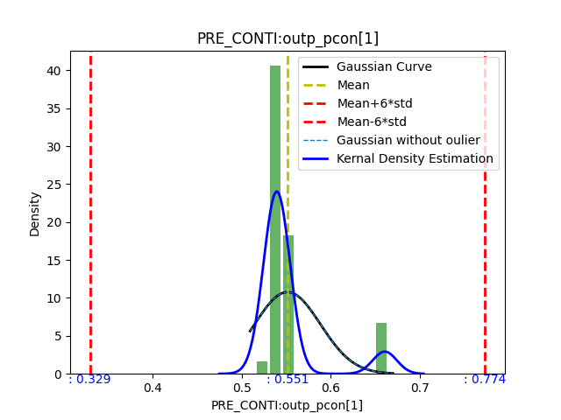
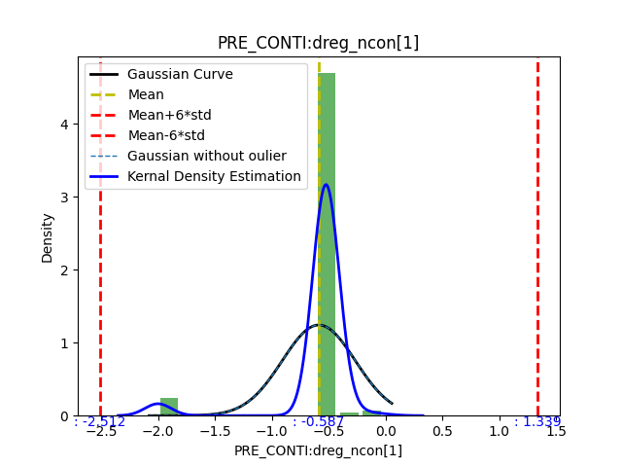
Left Skewed Graph
Right Skewed Graph

Slide 38
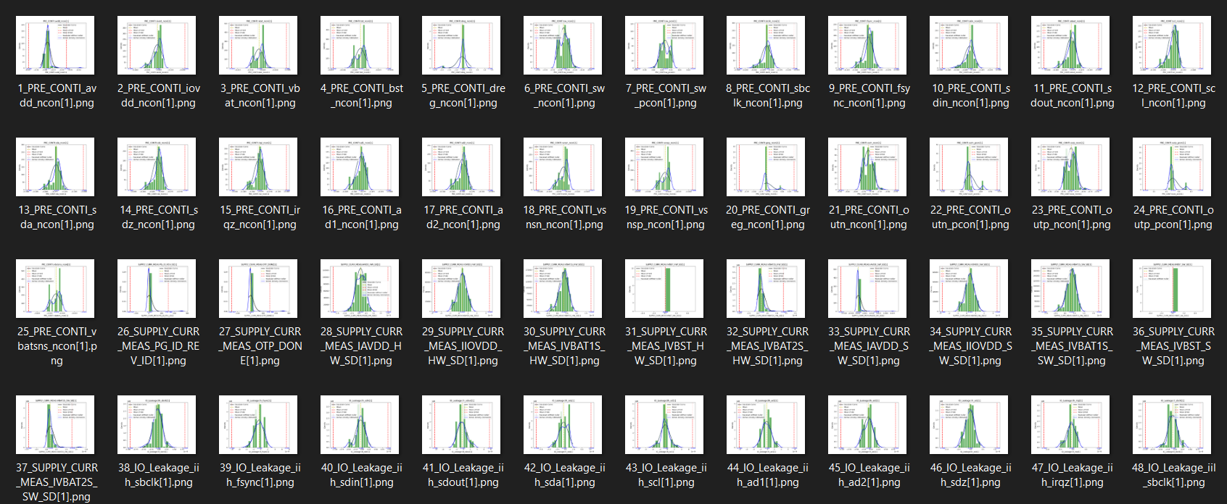
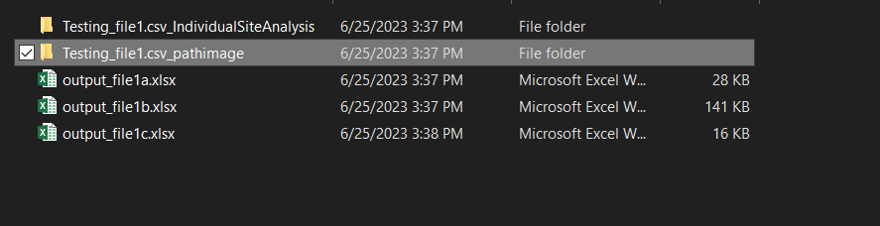
If the checkmark is selected then a Folder is automatically created inside the output folder which stores all the individual graphs (pathimage Folder)
All the graphs are properly named so that for a particular parameter it can be found easily
(Output Folder)

Slide 39
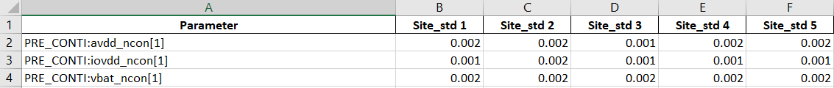
Site wise Analysis: Site wise mean Drift and Site wise std Drift is calculated along individual Site wise Mean,Std
It is also important to know the functioning of every site . Data is filtered for every site and the analysis is done site wise. Drift tells about the deviation in the values of the sites .If any site is not performing as expected we can see a large drift in that site
Marks the bad Site wise Drifts in the output for the user.

Slide 40
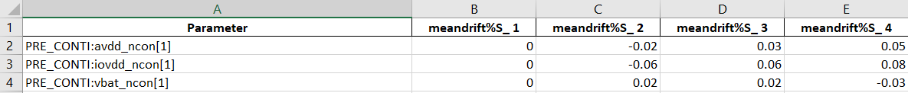
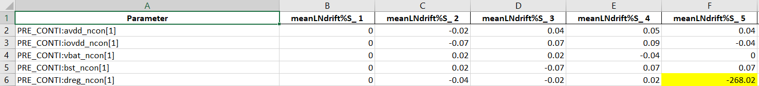

Slide 41
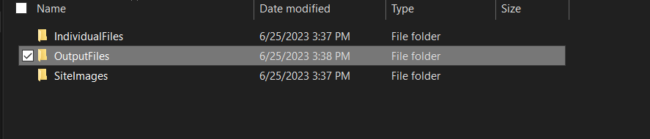
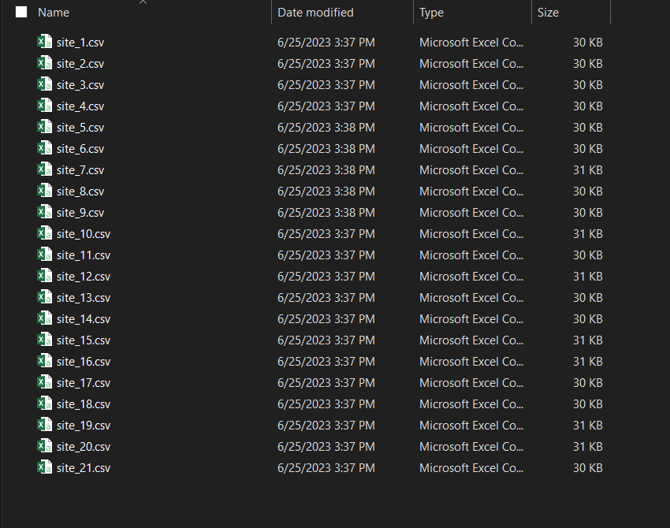
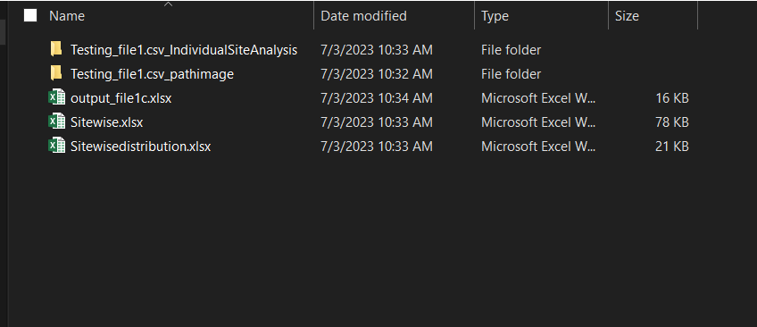
Intermediate Files: Added a checkmark in GUI to get Filtered Input file for all the Sites is formed, Filtered Output files for all the Site is Formed. If we want to get the data of a particular site it can be obtained or If we want to get the overall analysis for a particular Site it can also be obtained
If we want to obtain the analysis of a particular Site. Individual Site wise analysis files are formed that reflects the working of a particular site

Slide 42
Graphs for all the Individual Site parameter: Adding a checkmark in GUI that saves distribution plot for every site and its every parameter if we want to check for the specific site and specific parameter
Site wise Distribution: Site wise distribution that shows the Distribution of the parameter across every Site
Marks the bad Sites having bad Distribution

Slide 43
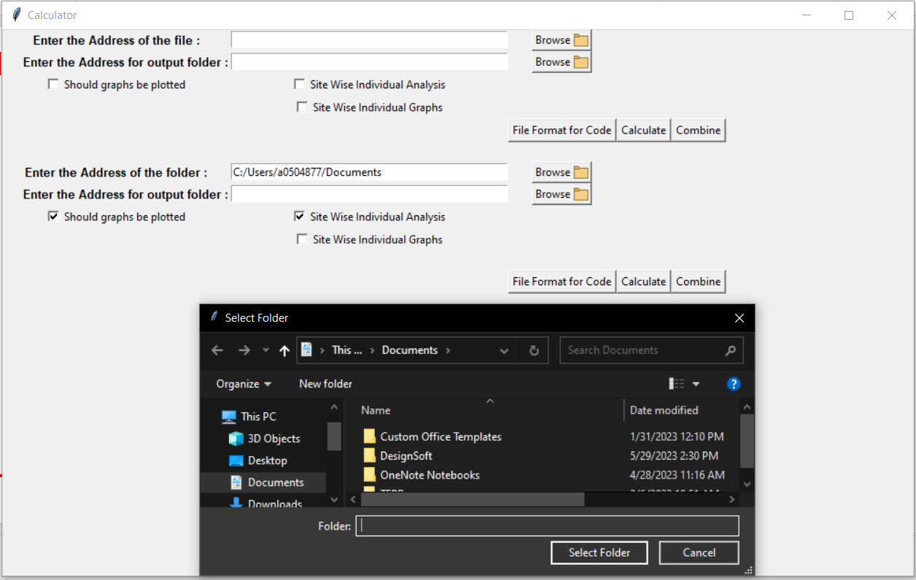
Multiple File Analysis Feature: Separate Input in the GUI to give Multiple files instead of a single File the code can also ask for the folder location in which multiple files are stored .It will merge it to give the analysis
We can choose location of the folder

Slide 44
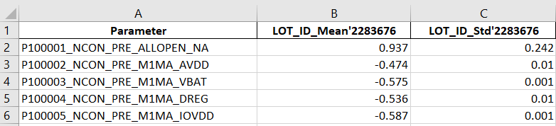
Proposed solution :Production File
The format of the Production File is Different from the Engineering File and a separate limit file is provided
The Automatically Maps the Parameter with the limits and forms a temporary file and does the same analysis as of the Engineering File
It has only one Additional File that does the Lot wise analysis
It also works for the Multiple files
Created a separate GUI for the Production File
Lot Wise Analysis

Slide 45
Alert Message at the End
Shows this message at the end when the GUI has executed the whole process
Minimum Hard-Coded things in the code , Only Slight modification is required to make it work for some different kind of file
Another column Peaks column which will tell the if the distribution is multimodal ,Unimodal etc. is to be implemeted

Slide 46
Problem statement 3: 1) Testing the ATE Char Board in the for the and checking for the FFT plot after INA,Voltage Divider Network

Slide 47
It was observed in the ATE Lab that harmonics were introduced after the Voltage Divider Circuit so verified the THDN values and the FFT plots in the Bench lab for the ATE Char Board and LSR Board
Circuit For the ATE Char board:

Slide 48
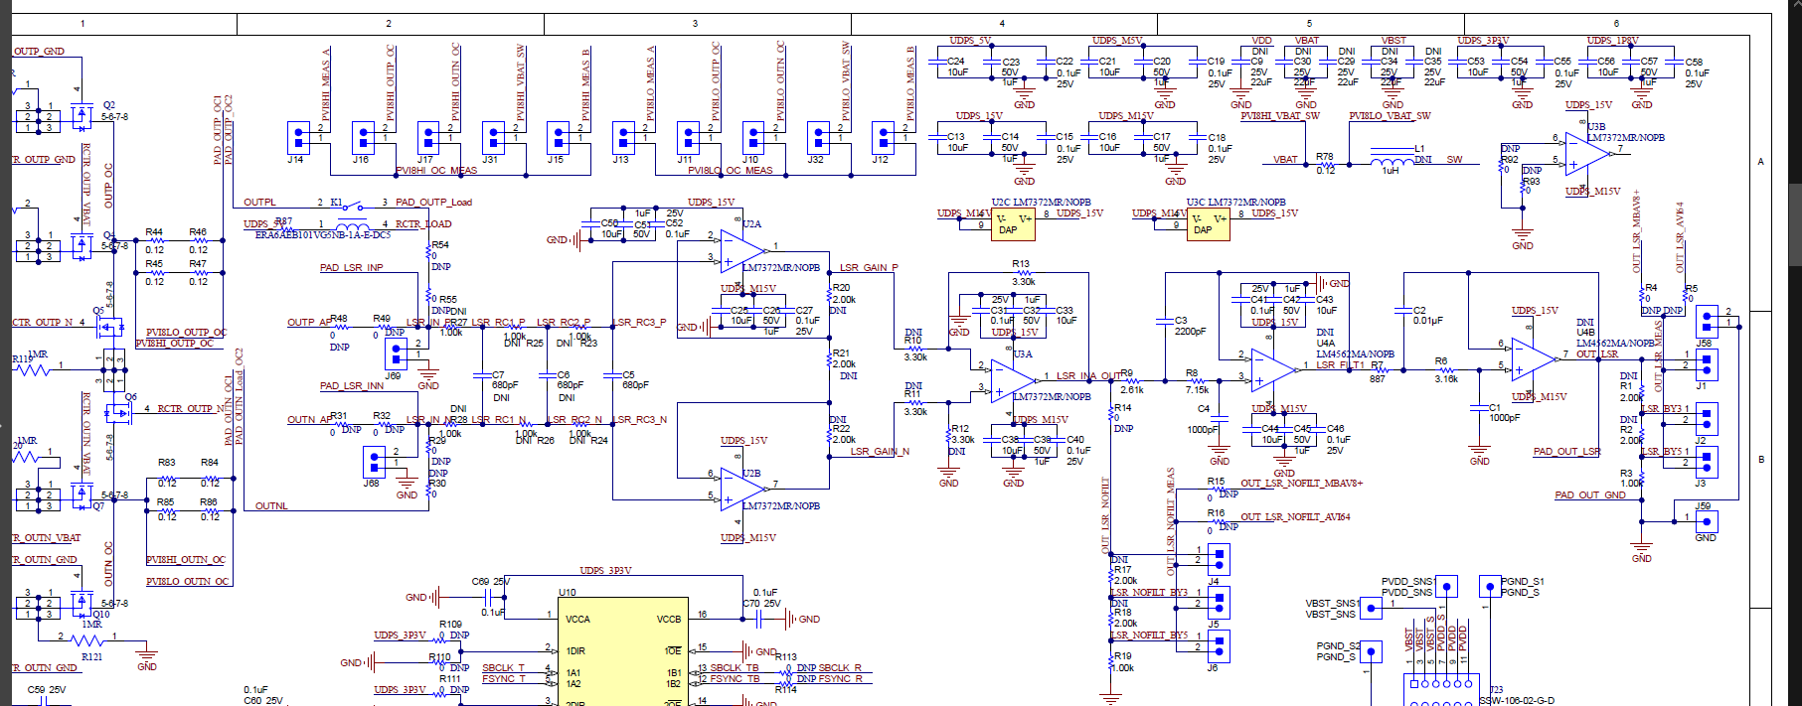
ATE Char Board

